Slide 1
Analyzing Brain Stroke Data:
An Exploration of Patient Attributes and Risk Factors
By: Lauren Carter, Kevin
Curry, Domenic Guerrero, Micah Purdome, and Sandeep Singh

Slide 2

Executive Summary
Research Question: How effectively can machine learning models predict stroke risk based on patient attributes, and which features—such as age, glucose levels, and BMI—are the most significant predictors?
Hypothesis: Machine learning models will effectively predict stroke outcomes by capturing complex patterns among patient attributes. Models should achieve high accuracy, particularly when using techniques like stratified cross-validation and feature scaling to address data balance and distribution issues.
Project Goals:
To identify which machine learning model most accurately predicts stroke risks in patients, focusing on attributes like age, glucose levels, and BMI.
To provide insights into risk factors, aiming to help healthcare providers identify high-risk patients more effectively.
Notes:
Explored Multiple Machine Learning Models: We tested various machine learning models, including Logistic Regression, Decision Trees, Gradient Boosting, and K-Nearest Neighbors. After rigorous testing, the Random Forest model emerged as the top performer across all performance metrics.
Data Preparation and Feature Handling: Our dataset contained both continuous features (e.g., age, BMI, and average glucose level) and categorical features (e.g., gender, work type, smoking status). Random Forest handled this mix effectively, capturing complex interactions in the data without extensive feature adjustments.
Model Evaluation and Optimization: We used stratified cross-validation to maintain stroke distribution in each fold, achieving an average accuracy of 94.86% with a low standard deviation of 0.27%, demonstrating both high accuracy and stability across data splits.
Hyperparameter Tuning with Grid Search: To further refine performance, we used Grid Search for optimal hyperparameters, finding that a tree depth of 7 and 500 trees offered the best balance of accuracy (94.72% on test data) and computational efficiency.

Slide 3
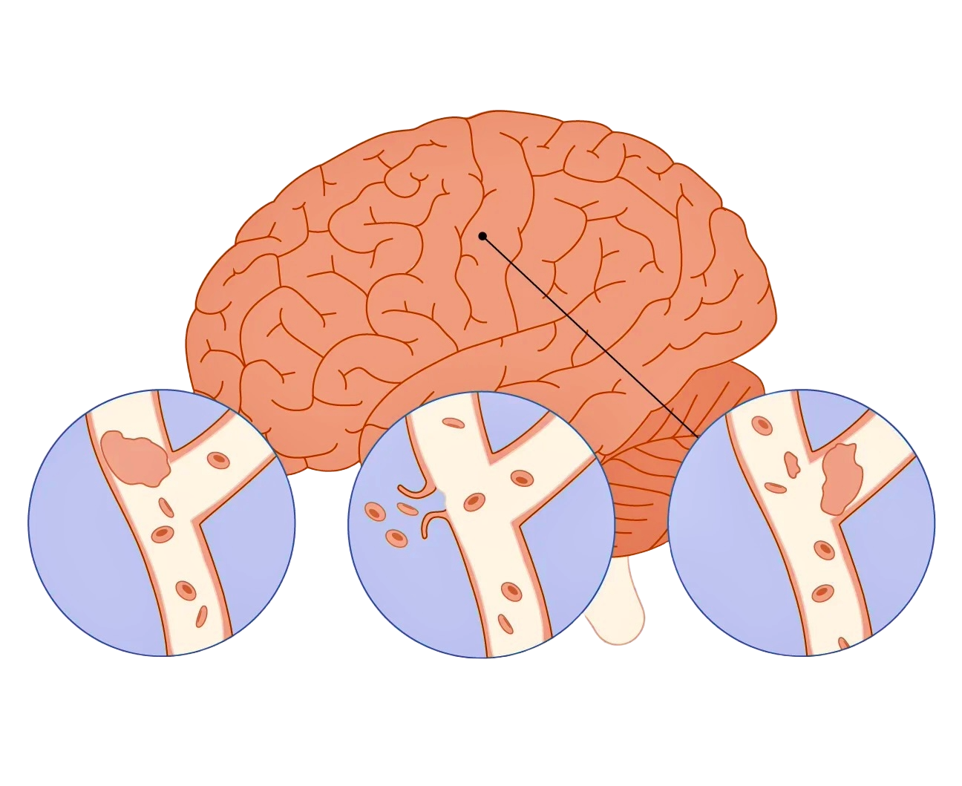
Background
TYPES OF STROKE
Brain stroke is the 5th Leading cause of death and the leading cause of disability in the United States
A stroke occurs when a blood vessel that carries oxygen and nutrients to the brain is either blocked by a clot or bursts (or ruptures).
High blood pressure is a leading cause of stroke. It occurs when the pressure of the blood in your arteries is too high.
High Glucose levels almost doubles chances of stroke.
Strokes can and Do occur at ANY age. Nearly one quarter of strokes occur under the age of 65. The risk of stroke more than doubles each decade after the age of 55.
80% OF STROKES ARE PREVENTABLE!!
Ischemic Stroke
Hemorrhagic Stroke
Transient Stroke

Slide 4
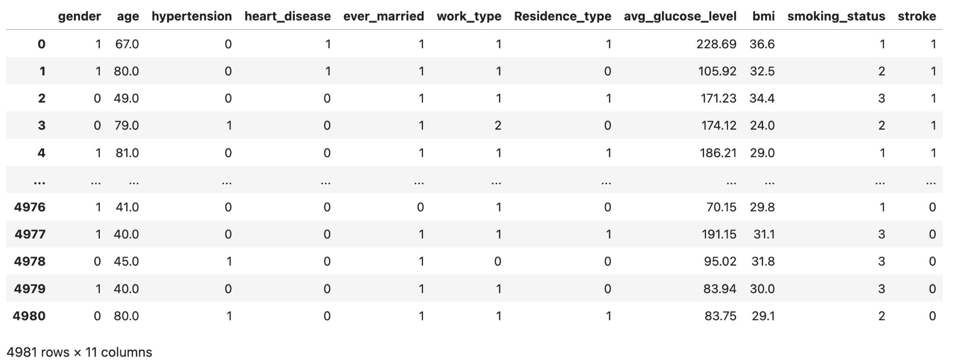
Data Processing
Data Cleaning Process:
Missing Values: No missing values
Data Type Check: Verified continuous and categorical types for model compatibility.
Encoding: Converted categorical features using Label Encoding for analysis.
Dataset Overview:
Source: Brain Stroke Dataset (Kaggle)
Size: 4,981 rows, 11 columns
Attributes:
Continuous: Age, Avg Glucose Level, BMI
Categorical: Gender, Hypertension, Heart Disease, Ever Married, Work Type, Residence Type, Smoking Status
Target Variable: Stroke (1 = Stroke, 0 = No Stroke)

Slide 5
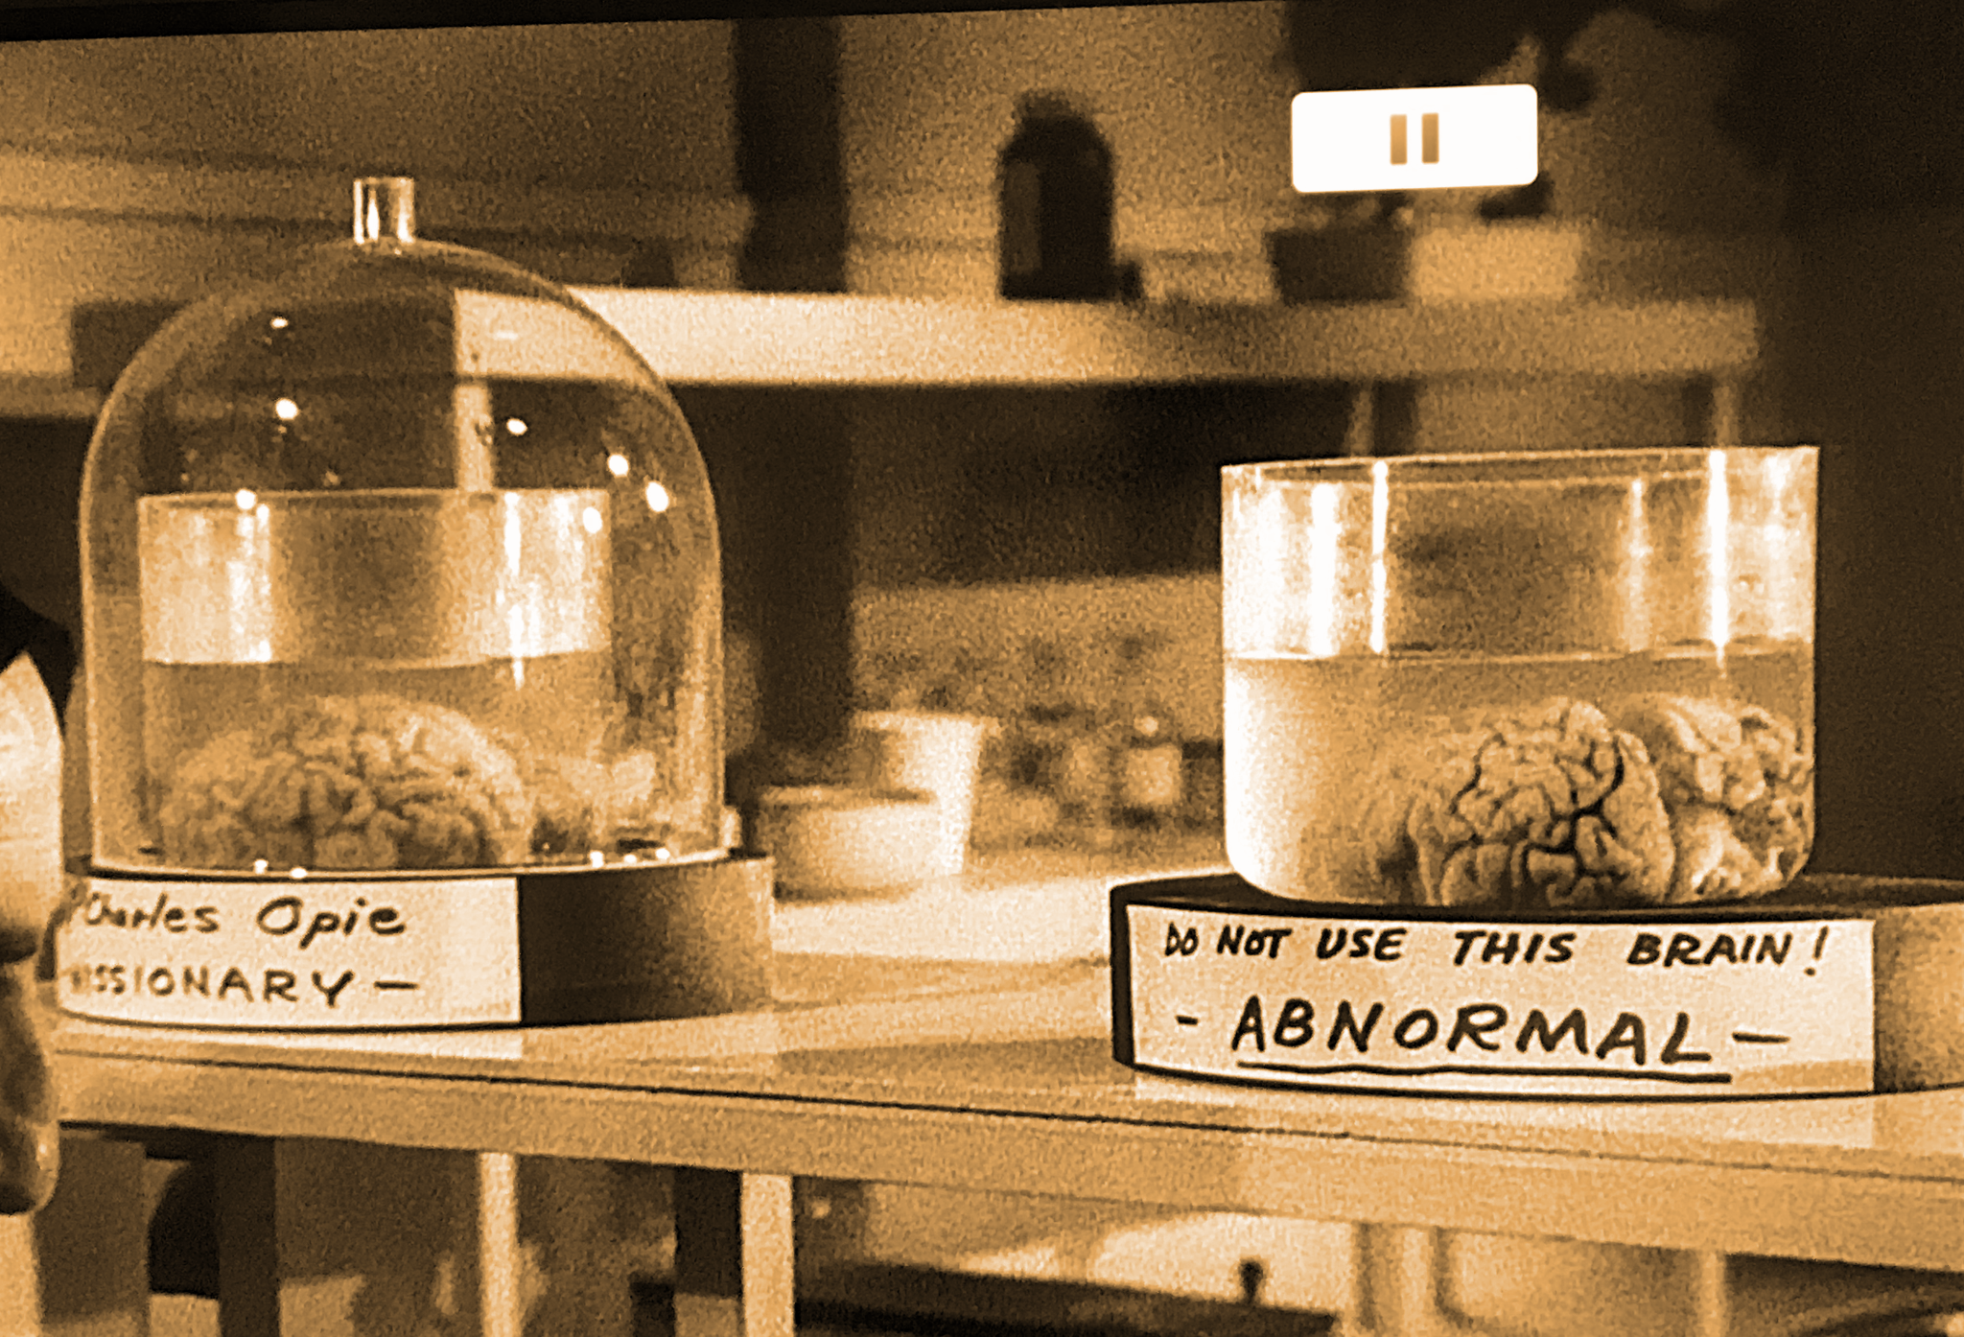
Methods
We used five models to train our dataset:
K Nearest Neighbor (KNN)
Decision Tree
Gradient Boosting
Random Forest
Logistic Regression
All models used Grid Search and Stratified Cross-validation for optimization.
In our study, the Random Forest model achieved notably better results than other models tested.

Slide 6
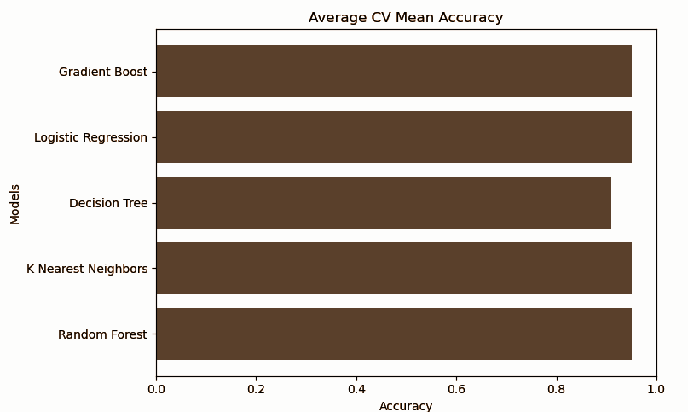
Best Model
Here’s a comparison based on the top two outputs:
The Random Forest model reached a cross validated score of ~95.1%, and was selected due to its strong handling of complex feature interactions, which contributed to a higher predictive accuracy compared to other models.
The Logistic Regression model reached accuracies of 95.12% in training and 94.78% in testing, but it struggled with the data's complexity due to incorrect penalty settings, causing frequent fitting failures.
Notes:
Sandeep’s Slide

Slide 7
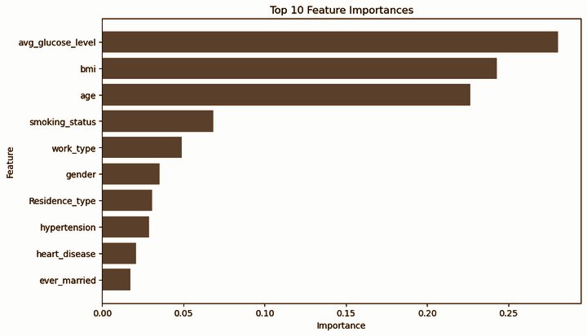
Results
In conclusion Random Forest model was the most optimal model specifically when the Grid Search method is applied (resulting in a performance boost of 91% to 94%)
We determined that Average Glucose Level has the strongest corollary relationship with strokes and can reliably be used as a predictor

Slide 8
Next Steps
01
02
03
04
Limitations
Additional Research
The primary limitations we encountered were the absence of lethality data, small sample size, and lack of temporal/geographical data.
The next step for this project would be to find data on the likelihood of surviving the strokes.
Other Questions
Future Directions
Does living in an urban or rural area influence your risk of having a stroke? Why did our data find Average Glucose Level as the strongest feature rather than Hypertension?
We would pursue a larger dataset and additional fine-tuning to cross-reference and continue improving our findings.
The most financially lucrative opportunity provided by this data would be to sell it to insurance agencies.

Slide 9
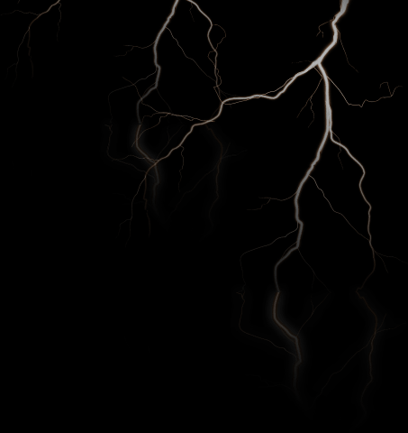
REFERENCES
Addythokale. (2023, February 24). Brain stroke prediction. Kaggle. https://www.kaggle.com/code/addythokale/brain-stroke-prediction
Adhamalahmady. (2024, May 12). Brain_Stroke_Model. Kaggle. https://www.kaggle.com/code/adhamalahmady/brain-stroke-model
Mosenzon, O., Cheng, A. Y., Rabinstein, A. A., & Sacco, S. (2023). Diabetes and Stroke: What Are the Connections?. Journal of stroke, 25(1), 26–38. https://doi.org/10.5853/jos.2022.02306
Stroke. (2024, September 9). Cleveland Clinic. https://my.clevelandclinic.org/health/diseases/5601-stroke

